Slide 1
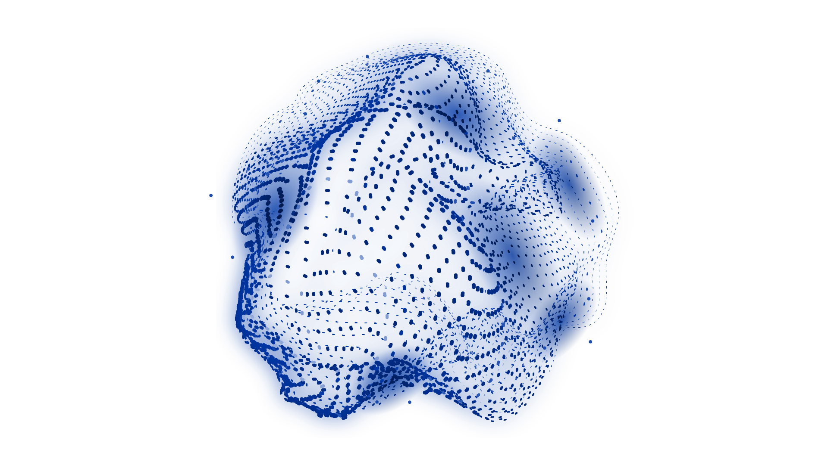

GENERATIVE
ADVERSARIAL
NETWORKS
AI Society University of Southampton
From Real-World Problems to Practical Implementations
Monday, Feb 24th 2025
Alberto Berni - ab3u21@soton.ac.uk

Slide 2

LEARNING OUTCOMES
Core Concepts
Mathematical Insight
Algorithmic Operations
Practical Implementations
Notes:
Learning Outcomes:
Conceptual Understanding:
Grasp the adversarial framework of GANs, including the roles of the Generator and Discriminator.
Mathematical Foundations:
Derive and explain the minimax objective function and related equations (e.g., Jensen-Shannon divergence).
Algorithmic Insight:
Understand the step-by-step training process and the significance of loss functions and optimization techniques in GANs.
Practical Implementation:
Gain hands-on experience by implementing and evaluating a simple GAN (e.g., using the MNIST dataset).
Problem-Solving Strategies:
Identify common challenges such as mode collapse and training instability, and explore mitigation techniques.

Slide 3
PREREQUISITES
Neural Network Basics
Backpropagation Basics
Probability & Statistics
Python skills
Notes:
Learning Prerequisites:
Neural Network Basics:
Understanding of feedforward neural networks and fundamental deep learning concepts.
Backpropagation & Optimization:
Familiarity with backpropagation, gradient descent, and loss function optimization.
Probability & Statistics:
Basic knowledge of probability distributions and statistical concepts relevant to machine learning.
Programming Skills:
Experience in Python and exposure to deep learning libraries such as TensorFlow or PyTorch.

Slide 4
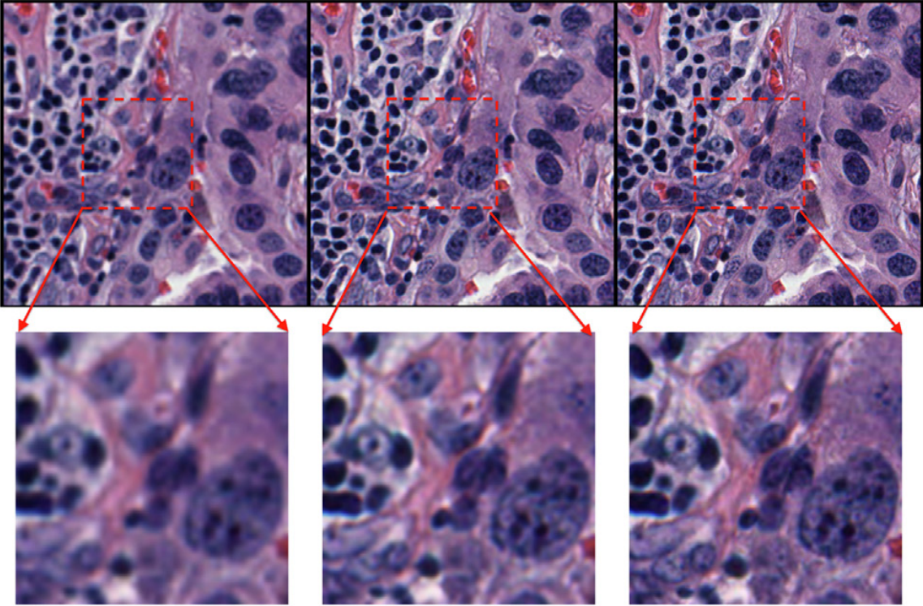
(Rong, Wang and Wen, 2023)
Notes:
FIRST Problem – Image Super-Resolution & Beyond
Challenges:
Low-resolution, noisy, and incomplete images common in medical imaging, satellite data, and historical photo restoration.
Traditional methods (e.g., interpolation, denoising filters) provide limited improvements.
GAN Solutions:
SRGAN, Denoising GANs, Image Inpainting GANs that learn to generate realistic details.
Impact:
Enhanced medical diagnostics, clearer satellite imagery, and improved security footage.
SECOND Problem – Data Scarcity & Imbalance
Challenges:
Limited or imbalanced datasets hinder model performance in fields like autonomous driving, fraud detection, and rare disease diagnosis.
Traditional Approaches:
Basic augmentations (rotations, flips) or SMOTE (mainly for tabular data) that fall short for complex data.
GAN Solutions:
Synthetic data generation that captures the true data distribution.
Examples: Synthetic X-rays for rare lung conditions, diverse driving scenarios.

Slide 5
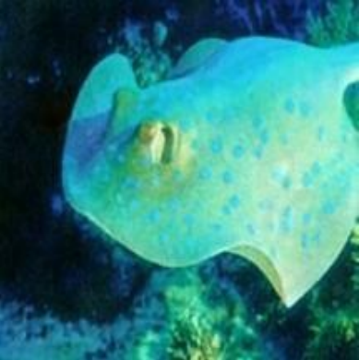
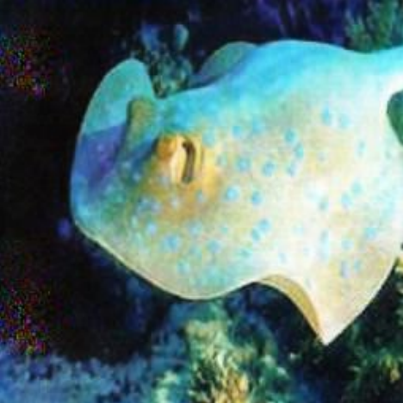
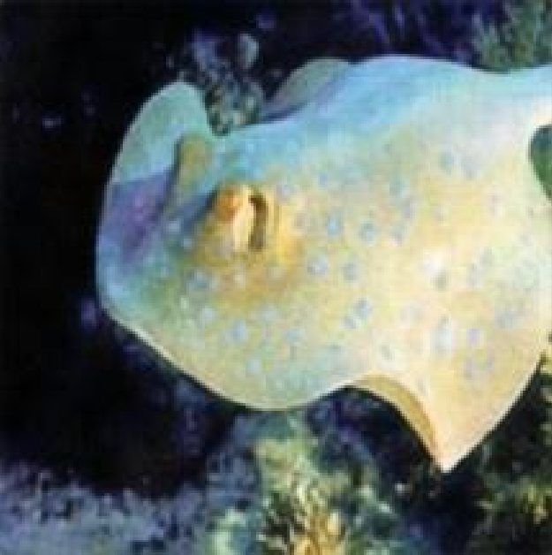
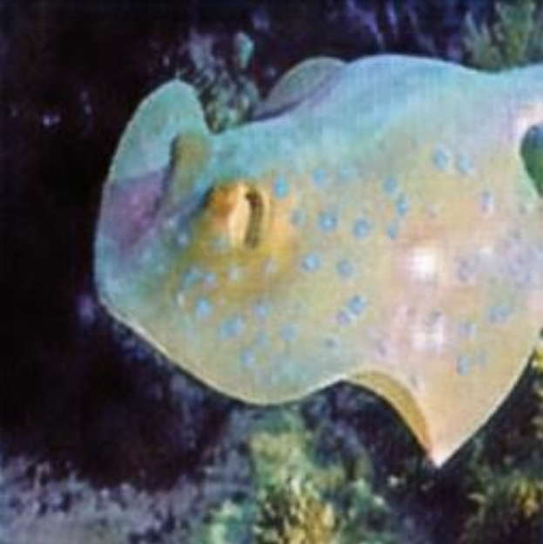
(a) Ground Truth
(h) UGAN
(f) UGAN
(g) CycleGAN
(Hu et al., 2021)
Notes:
FIRST Problem – Image Super-Resolution & Beyond
Challenges:
Low-resolution, noisy, and incomplete images common in medical imaging, satellite data, and historical photo restoration.
Traditional methods (e.g., interpolation, denoising filters) provide limited improvements.
GAN Solutions:
SRGAN, Denoising GANs, Image Inpainting GANs that learn to generate realistic details.
Impact:
Enhanced medical diagnostics, clearer satellite imagery, and improved security footage.
SECOND Problem – Data Scarcity & Imbalance
Challenges:
Limited or imbalanced datasets hinder model performance in fields like autonomous driving, fraud detection, and rare disease diagnosis.
Traditional Approaches:
Basic augmentations (rotations, flips) or SMOTE (mainly for tabular data) that fall short for complex data.
GAN Solutions:
Synthetic data generation that captures the true data distribution.
Examples: Synthetic X-rays for rare lung conditions, diverse driving scenarios.

Slide 6
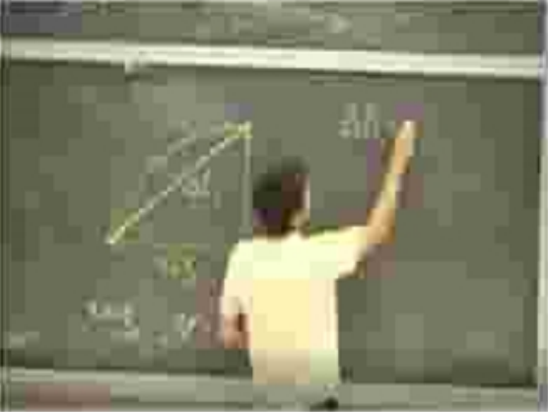
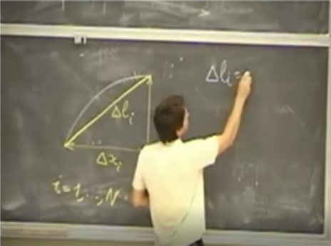
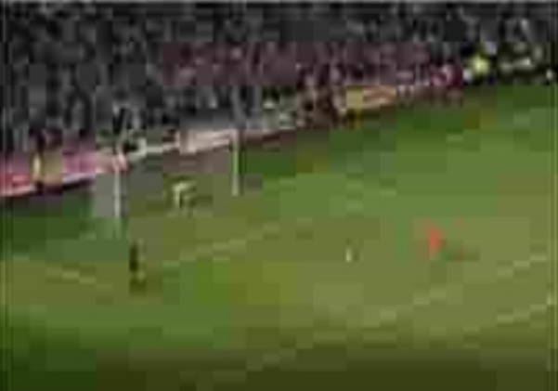
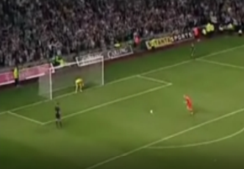
FURTHER USES
Synthetic Data Generation
Image Generation
(Hazra and Byun, 2020)
Notes:
The Promise of GANs – Beyond Traditional Methods
Core Idea:
GANs learn the data distribution implicitly through adversarial training.
Key Benefits:
High-Quality Data Generation: Realistic and diverse synthetic samples.
Data Augmentation & Enhancement: Tackling scarcity and improving existing datasets.
Implicit Density Estimation: No need for an explicit model of the data distribution.

Slide 7
LEARNING OUTCOMES
Core Concepts
Mathematical Insight
Algorithmic Operations
Practical Implementations
Notes:
Learning Outcomes:
Conceptual Understanding:
Grasp the adversarial framework of GANs, including the roles of the Generator and Discriminator.
Mathematical Foundations:
Derive and explain the minimax objective function and related equations (e.g., Jensen-Shannon divergence).
Algorithmic Insight:
Understand the step-by-step training process and the significance of loss functions and optimization techniques in GANs.
Practical Implementation:
Gain hands-on experience by implementing and evaluating a simple GAN (e.g., using the MNIST dataset).
Problem-Solving Strategies:
Identify common challenges such as mode collapse and training instability, and explore mitigation techniques.

Slide 8
COUNTERFEITER AND DETECTIVE
GANs learn data distributions through adversarial training
(Goodfellow et al., 2014)
Generator (Counterfeiter)
Transforms a noise vector z into synthetic data G(z).
Dataset
Discriminator Loss
Discriminator
Discriminator (Detective):
Receives a sample x (real or fake) outputs a probability D(x) indicating its authenticity.
0 ≤ D(x)≤ 1
Generator
Generator
Loss
Notes:
The Counterfeiter and the Detective
Core Idea:
GANs learn the data distribution implicitly through adversarial training.
Adversarial Framework:
A two-player zero-sum game where one network’s gain is the other’s loss.
Analogy:
Generator (Counterfeiter):
Discriminator (Detective):
Goal:
The Generator tries to “fool” the Discriminator, while the Discriminator strives to correctly classify samples.

Slide 9
LEARNING OUTCOMES
Core Concepts
Mathematical Insight
Algorithmic Operations
Practical Implementations
Notes:
Learning Outcomes:
Conceptual Understanding:
Grasp the adversarial framework of GANs, including the roles of the Generator and Discriminator.
Mathematical Foundations:
Derive and explain the minimax objective function and related equations (e.g., Jensen-Shannon divergence).
Algorithmic Insight:
Understand the step-by-step training process and the significance of loss functions and optimization techniques in GANs.
Practical Implementation:
Gain hands-on experience by implementing and evaluating a simple GAN (e.g., using the MNIST dataset).
Problem-Solving Strategies:
Identify common challenges such as mode collapse and training instability, and explore mitigation techniques.

Slide 10
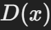
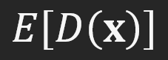
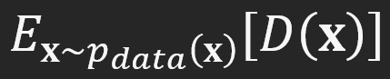
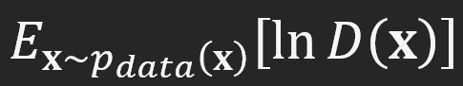

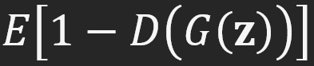
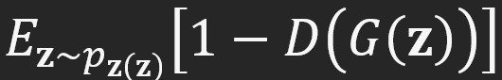
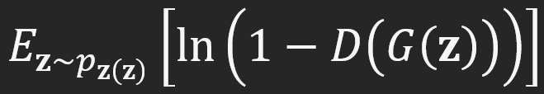
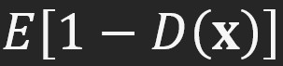
ADVERSARIAL FRAMEWORK
Nash Equilibrium
(Nash, 1951)
A two-player, zero-sum game where one network’s gain is the other’s loss.
Discriminator
D(x) → 1
Prediction
Error
From a Distribution
Log Error Form
Generator
D(G(z)) → 0
Generation
Error
From a Distribution
Log Error Form
Cross-Entropy
Wrong Prediction

Slide 11
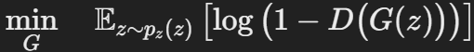
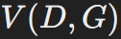
ADVERSARIAL OBJECTIVES
Discriminator
Generator
Classify Real and Generated data
Generate convincing Noise (fake data)
GAN Objective
Low V
Generator is winning
Adversarial Loss
High V
Discriminator is winning

Slide 12
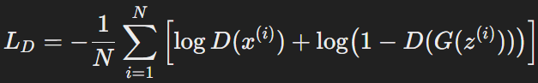
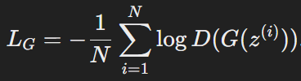
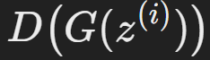
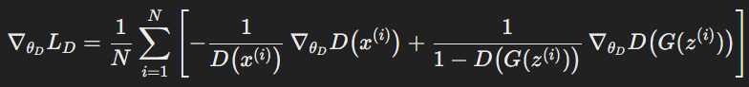
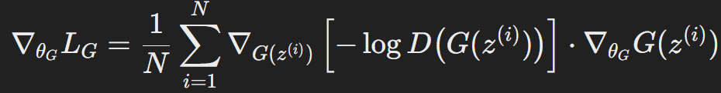
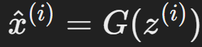
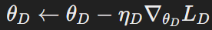
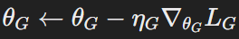
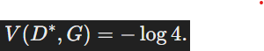
ADVERSARIAL TRAINING
GAN TRAINING LOOP
Data + Noise
Discriminator Updates
Repeat
Generator Updates
Classify Data
Generate Noise
Optimal Convergence Criteria
Notes:
THE KEY is how the loss L(G) propagates back to update G:
Gradients for each network are computed while treating the other network’s parameters as constant:
The discriminator's gradient is calculated with respect to its own parameters based on its performance on real and fake data.
The generator's gradient is computed by backpropagating through the discriminator, but only the generator’s parameters are updated in that step.

Slide 13
KAHOOT
Notes:
The key is how the loss LGL_GLG​ propagates back to update GGG:

Slide 14
LEARNING OUTCOMES
Core Concepts
Mathematical Insight
Algorithmic Operations
Practical Implementations
Notes:
Learning Outcomes:
Conceptual Understanding:
Grasp the adversarial framework of GANs, including the roles of the Generator and Discriminator.
Mathematical Foundations:
Derive and explain the minimax objective function and related equations (e.g., Jensen-Shannon divergence).
Algorithmic Insight:
Understand the step-by-step training process and the significance of loss functions and optimization techniques in GANs.
Practical Implementation:
Gain hands-on experience by implementing and evaluating a simple GAN (e.g., using the MNIST dataset).
Problem-Solving Strategies:
Identify common challenges such as mode collapse and training instability, and explore mitigation techniques.

Slide 15
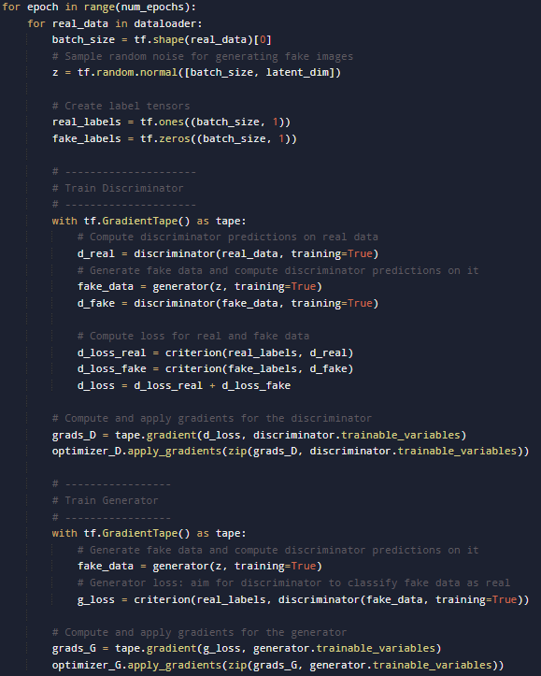
GAN TRAINING LOOP
Initialization:
Randomly initialize G and D.
Iterative Updates:
Discriminator Phase (multiple steps):
Sample mini-batches of real data x and noise z.
Compute loss on samples E[log⁡D(x) + ⁡(1−D(G(z)))]
Update D using gradient ascent.
Generator Phase (one step):
Sample new noise z, generate G(z).
Compute loss.
Update G using gradient descent.
Repeat until convergence:
V(D,G) = -log 4.
Notes:
Learning Outcomes:
Conceptual Understanding:
Grasp the adversarial framework of GANs, including the roles of the Generator and Discriminator.
Mathematical Foundations:
Derive and explain the minimax objective function and related equations (e.g., Jensen-Shannon divergence).
Algorithmic Insight:
Understand the step-by-step training process and the significance of loss functions and optimization techniques in GANs.
Practical Implementation:
Gain hands-on experience by implementing and evaluating a simple GAN (e.g., using the MNIST dataset).
Problem-Solving Strategies:
Identify common challenges such as mode collapse and training instability, and explore mitigation techniques.

Slide 16
LEARNING OUTCOMES
Core Concepts
Mathematical Insight
Algorithmic Operations
Practical Implementations
Notes:
Learning Outcomes:
Conceptual Understanding:
Grasp the adversarial framework of GANs, including the roles of the Generator and Discriminator.
Mathematical Foundations:
Derive and explain the minimax objective function and related equations (e.g., Jensen-Shannon divergence).
Algorithmic Insight:
Understand the step-by-step training process and the significance of loss functions and optimization techniques in GANs.
Practical Implementation:
Gain hands-on experience by implementing and evaluating a simple GAN (e.g., using the MNIST dataset).
Problem-Solving Strategies:
Identify common challenges such as mode collapse and training instability, and explore mitigation techniques.

Slide 17
PRACTICE TIME
GANs.ipynb
Notes:
Learning Outcomes:
Conceptual Understanding:
Grasp the adversarial framework of GANs, including the roles of the Generator and Discriminator.
Mathematical Foundations:
Derive and explain the minimax objective function and related equations (e.g., Jensen-Shannon divergence).
Algorithmic Insight:
Understand the step-by-step training process and the significance of loss functions and optimization techniques in GANs.
Practical Implementation:
Gain hands-on experience by implementing and evaluating a simple GAN (e.g., using the MNIST dataset).
Problem-Solving Strategies:
Identify common challenges such as mode collapse and training instability, and explore mitigation techniques.

Slide 18
FURTHER READING
Foundational Papers:
"Generative Adversarial Nets" by Goodfellow et al. (2014)
DCGAN, WGAN, StyleGAN, and BigGAN papers.
Books:
"Deep Learning" by Goodfellow, Bengio, and Courville.
"Generative Deep Learning" by David Foster.
Online Tutorials & Code Repositories:
TensorFlow GAN Tutorials, PyTorch GAN examples on GitHub.
The GAN Zoo (curated list of architectures).
Websites:
Papers with Code, ArXiv for the latest research.
Datasets:
Beginner: MNIST, Fashion-MNIST.
Intermediate/Advanced: CIFAR-10, CelebA, FFHQ (for faces), Oxford Flowers.
Sources: Kaggle, Hugging Face Datasets.
Project Ideas:
Implement a DCGAN for image synthesis.
Experiment with conditional GANs (cGAN) for controlled generation.
Explore advanced variants (StyleGAN, BigGAN) and analyze performance.
Notes:
Learning Outcomes:
Conceptual Understanding:
Grasp the adversarial framework of GANs, including the roles of the Generator and Discriminator.
Mathematical Foundations:
Derive and explain the minimax objective function and related equations (e.g., Jensen-Shannon divergence).
Algorithmic Insight:
Understand the step-by-step training process and the significance of loss functions and optimization techniques in GANs.
Practical Implementation:
Gain hands-on experience by implementing and evaluating a simple GAN (e.g., using the MNIST dataset).
Problem-Solving Strategies:
Identify common challenges such as mode collapse and training instability, and explore mitigation techniques.

Slide 19
REFERENCES
Rong, R., Wang, S. and Wen, Z. (2023). Enhanced Pathology Image Quality with Restore-Generative Adversarial Network. The American Journal of Pathology, 193(4), pp.404–416. doi:https://doi.org/10.1016/j.ajpath.2022.12.011.
Hu, K., Zhang, Y., Weng, C., Wang, P., Deng, Z. and Liu, Y. (2021). An Underwater Image Enhancement Algorithm Based on Generative Adversarial Network and Natural Image Quality Evaluation Index. Journal of Marine Science and Engineering, 9(7), p.691. doi:https://doi.org/10.3390/jmse9070691.
Hazra, D. and Byun, Y.-C. (2020). Upsampling Real-Time, Low-Resolution CCTV Videos Using Generative Adversarial Networks. Electronics, 9(8), p.1312. doi:https://doi.org/10.3390/electronics9081312.
Goodfellow, I.J., Pouget-Abadie, J., Mirza, M., Xu, B., Warde-Farley, D., Ozair, S., Courville, A. and Bengio, Y. (2014). Generative Adversarial Networks. arXiv (Cornell University), 1. doi:https://doi.org/10.48550/arxiv.1406.2661.
Nash, J. (1951). Non-Cooperative Game Theory. The Annals of Mathematics - Second Series, 54(2), pp.286–295. doi:https://dn720001.ca.archive.org/0/items/non-cooperative-games-nash/Non-cooperative%20games%20-%20nash_text.pdf.
Notes:
Learning Outcomes:
Conceptual Understanding:
Grasp the adversarial framework of GANs, including the roles of the Generator and Discriminator.
Mathematical Foundations:
Derive and explain the minimax objective function and related equations (e.g., Jensen-Shannon divergence).
Algorithmic Insight:
Understand the step-by-step training process and the significance of loss functions and optimization techniques in GANs.
Practical Implementation:
Gain hands-on experience by implementing and evaluating a simple GAN (e.g., using the MNIST dataset).
Problem-Solving Strategies:
Identify common challenges such as mode collapse and training instability, and explore mitigation techniques.

